Slide 1
COSC 6378 FINAL PROJECT PRESENTATION
THE ECONOMIC STRENGTH AND GROWTH OF TEXAS!
DATA VISUALIZATION
BY TOCHUKWU IHEANACHO

Slide 2
CHALLENGES I FACED DURING THE PROJECT
Selecting proper visual metaphors
Legibility without too much reliance legends and labels
Data density and credibility
Low Tableau Skill
Establish Data relationships and data cleaning

Slide 3
Background information
Texas had a population of 28.6 million people in 2020, with a median age of 34.8 and a typical family income of $63,826. Texas' population increased from 28.3 million to 28.6 million, a 1.33 percent rise, and its median household income increased from $61,874 to $63,826, a 3.15 percent increase, between 2019 and 2020.
The 5 largest ethnic groups in Texas are White (Non-Hispanic) (41.4%), White (Hispanic) (27.8%), Black or African American (Non-Hispanic) (11.8%), Other (Hispanic) (6.05%), and Two+ (Hispanic) (4.94%).
35.1% of the households in Texas reported speaking a non-English language at home as their primary shared language. This does not consider the potential multi-lingual nature of households, but only the primary self-reported language spoken by all members of the household.
89.7% of the residents in Texas are U.S. citizens.
The largest universities in Texas are Texas A & M University-College Station (19,611 degrees awarded in 2020), The University of Texas at Austin (15,363 degrees), and The University of Texas at Arlington (14,095 degrees).
In 2020, the median property value in Texas was $187,200, and the homeownership rate was 62.3%. Most people in Texas drove alone to work, and the average commute time was 26.6 minutes. The average car ownership in Texas was 2 cars per household.
Texas borders Arkansas, Louisiana, New Mexico, and Oklahoma.

Slide 4
In Texas, the median family income is $63,826. In 2020, the county with the highest Median Household Income in Texas was Rockwall County, TX with a value of $105,956, followed by Collin County, TX and Fort Bend County, TX, with respective values of $100,541 and $100,189.
Males in Texas have an average income that is 1.39 times more than females, who have an average income of $50,589. The income inequality in Texas (measured using the Gini index) is 0.478, which is greater than than the national average.
Texas' economy employs 12.7 million people. Construction (993,462 people), Elementary & secondary schools (899,993 people), and Restaurants & Food Services (866,707 people) are the major sectors in Texas, and the top paid businesses are Oil & gas extraction ($139,961) and Software publishing (866,707 people).

Slide 5
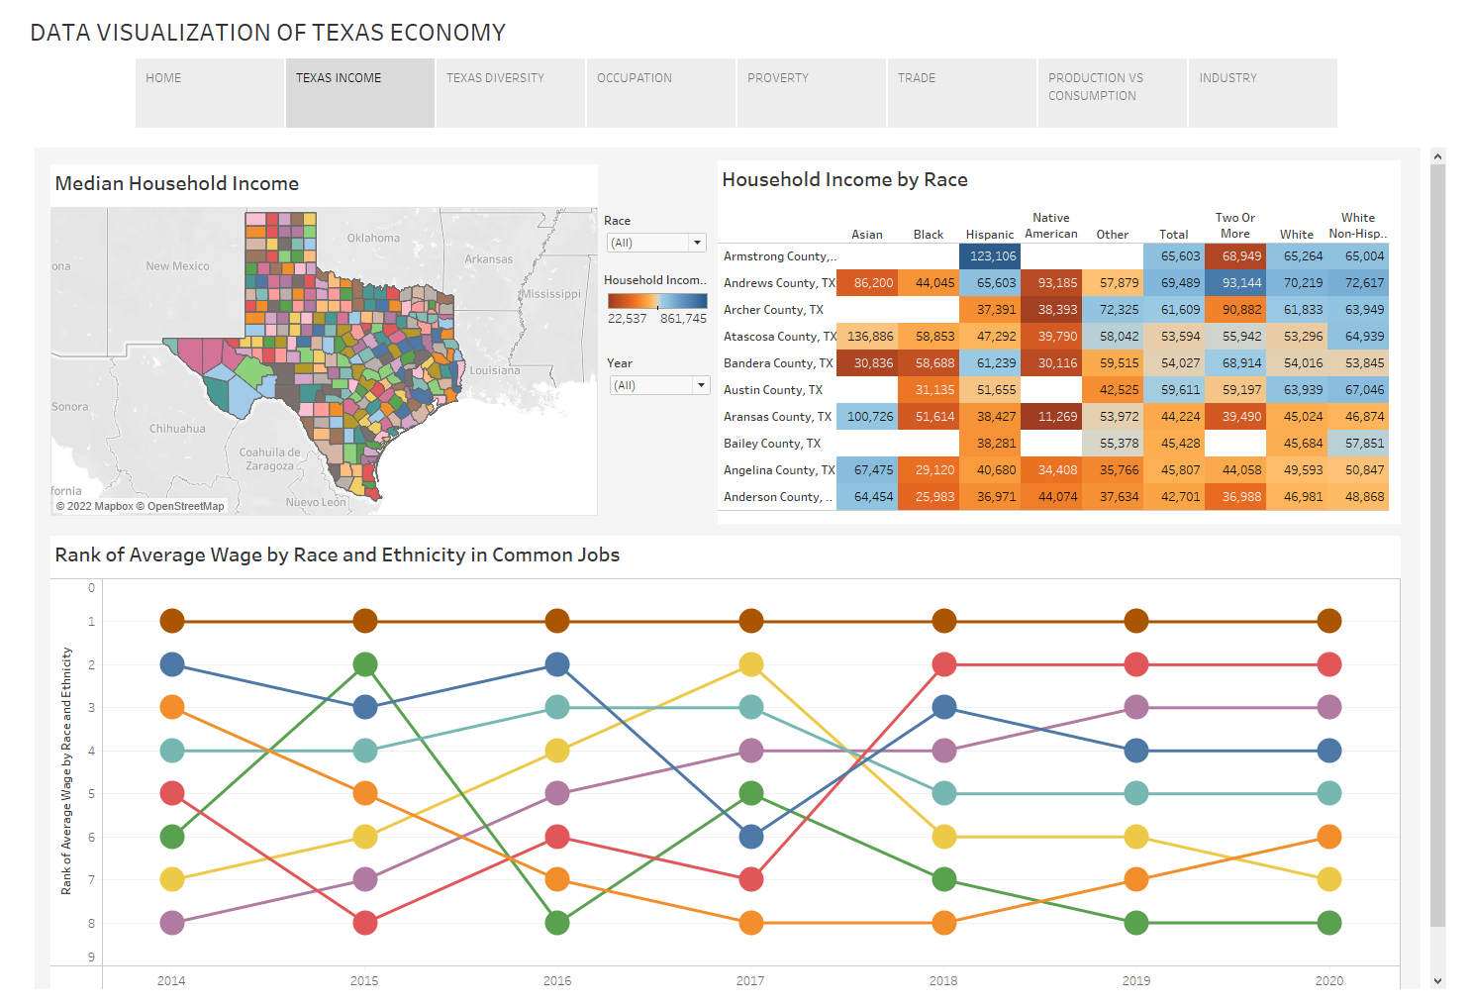

Slide 6
Employment by Industry Sector
Data is only available at the state level. Showing data for Texas.
Monthly Growth (Year-over-Year)
8.45%
YEAR-OVER-YEAR GROWTH
Employment change between May 2020 and May 2021
As of May 2021, there are 145M people employed in Texas. This represents a 8.45% increase in employment when compared to May 2020.
The following chart shows monthly employment numbers for each industry sector in Texas.
Data from the Bureau of Labor Statistics Current Employment Statistics (CES). https://www.bls.gov/data/#employment

Slide 7
WAGES
Median Household Income
$63,826
2020 VALUE
± $218
3.15%
1 YEAR GROWTH
± 0.465%
Households in Texas have a median annual income of $63,826, which is less than the median annual income of $64,994 across the entire United States. This is in comparison to a median income of $61,874 in 2019, which represents a 3.15% annual growth.
The following chart shows how the median household income in Texas compares to that of its neighboring and parent geographies.
Data from the Census Bureau ACS 5-year Estimate. http://www.census.gov/programs-surveys/acs/

Slide 8
Wage by Sex in Common Jobs
AVERAGE MALE SALARY IN TEXAS : $70,236 | ± $745
AVERAGE FEMALE SALARY IN TEXAS: $50,589 | ± $558
In 2020, full-time male employees in Texas made 1.39 times more than female employees.
This chart shows the sex-based wage disparity in the 5 most common occupations in Texas by number of full-time employees.

Slide 9
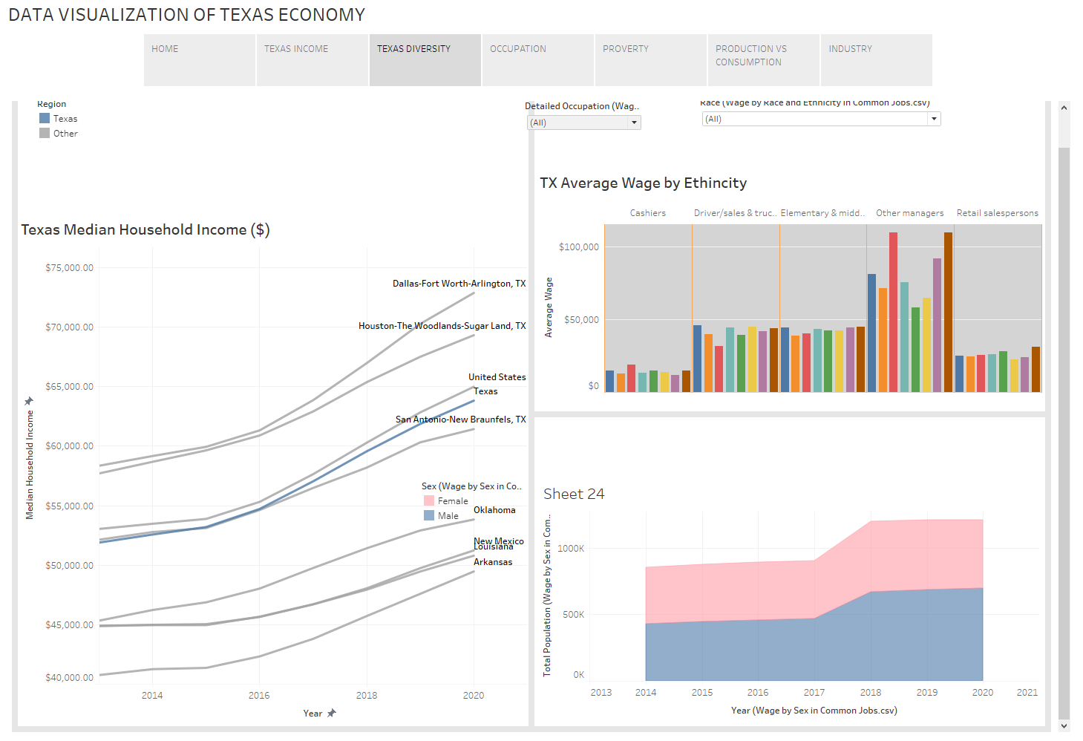

Slide 10
HIGHEST AVERAGE SALARIES BY RACE & ETHNICITY IN TEXAS
Asian : $71,020 ± $2,237
White: $57,454 ± $557
American Indian : $48,111 ± $6,839
In 2020 the highest paid race/ethnicity of Texas workers was Asian. These workers were paid 1.24 times more than White workers, who made the second highest salary of any race/ethnicity in Texas.
This chart shows the race- and ethnicity-based wage disparities in the 5 most common occupations in Texas by number of full-time employees.
Data from the Census Bureau ACS PUMS 5-Year Estimate. http://www.census.gov/programs-surveys/acs/

Slide 11
Wage Distribution
2020 WAGE GINI IN TEXAS : 0.478
2019 WAGE GINI IN TEXAS: 0.48
In 2020, the income inequality in Texas was 0.478 according to the GINI calculation of the wage distribution. Income inequality had a 0.474% decline from 2019 to 2020, which means that wage distribution grew somewhat more even. The GINI for Texas was higher than than the national average of 0.478. In other words, wages are distributed less evenly in Texas in comparison to the national average.
This chart shows the number of workers in Texas across various wage buckets compared to the national average.
Data from the Census Bureau ACS PUMS 5-Year Estimate. http://www.census.gov/programs-surveys/acs/

Slide 12
Income by Location
HIGHEST MEDIAN HOUSEHOLD INCOME (TOTAL)
Rockwall County, TX
Collin County, TX
Fort Bend County, TX
In 2020, the county with the highest Median Household Income (Total) in Texas was Rockwall County, TX with a value of $105,956, followed by Collin County, TX and Fort Bend County, TX, with respective values of $100,541 and $100,189.

Slide 13
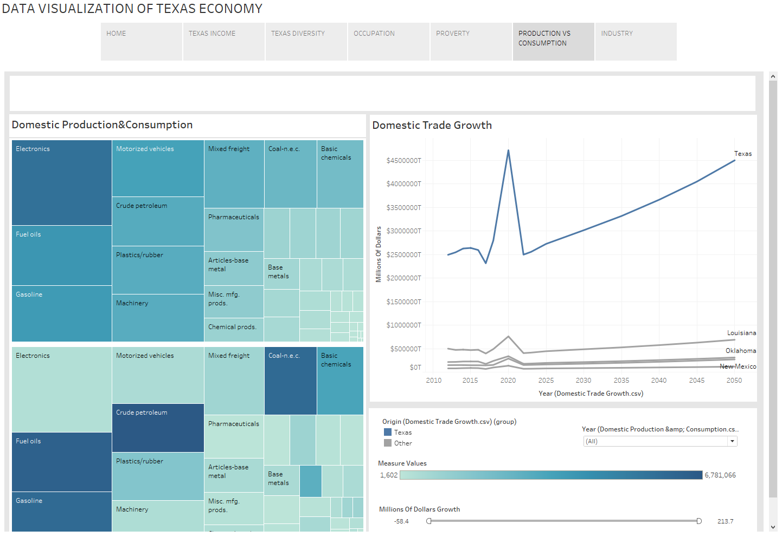

Slide 14
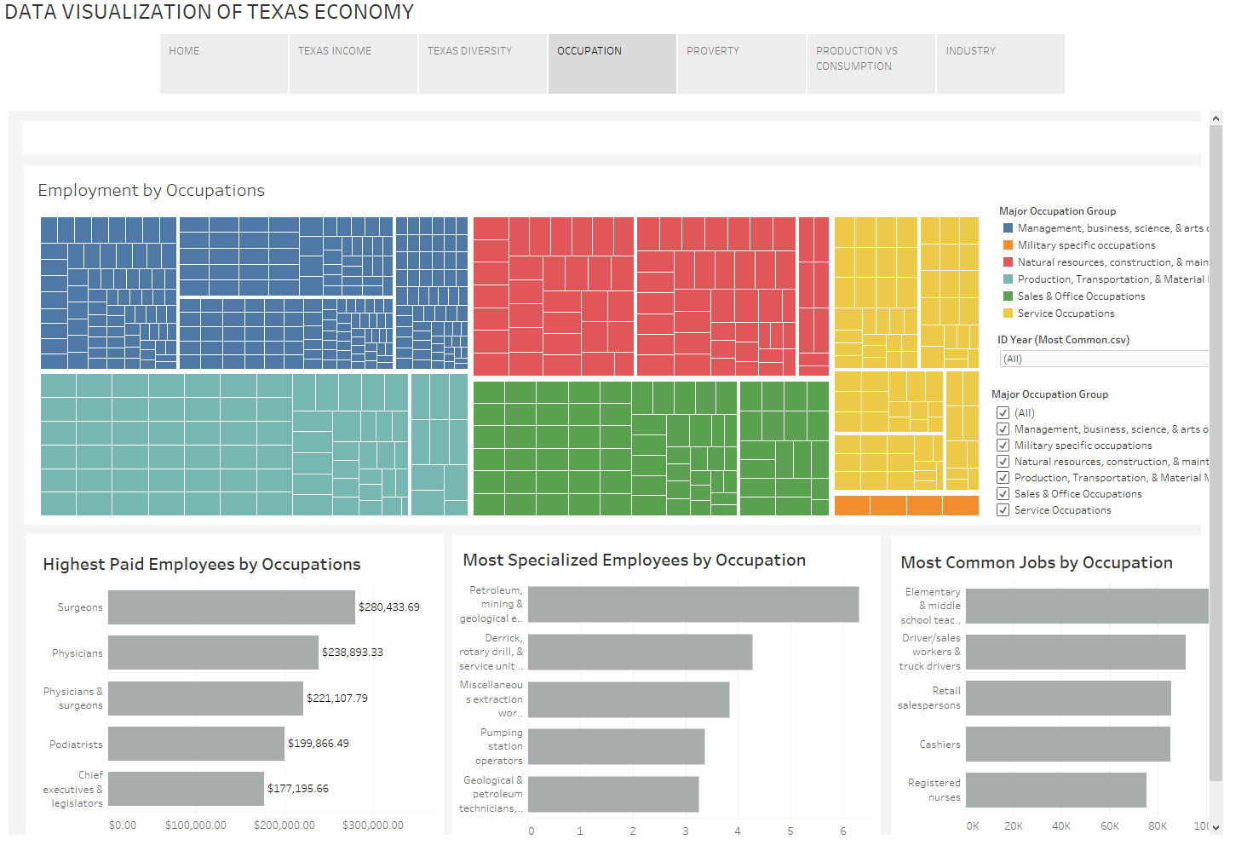

Slide 15
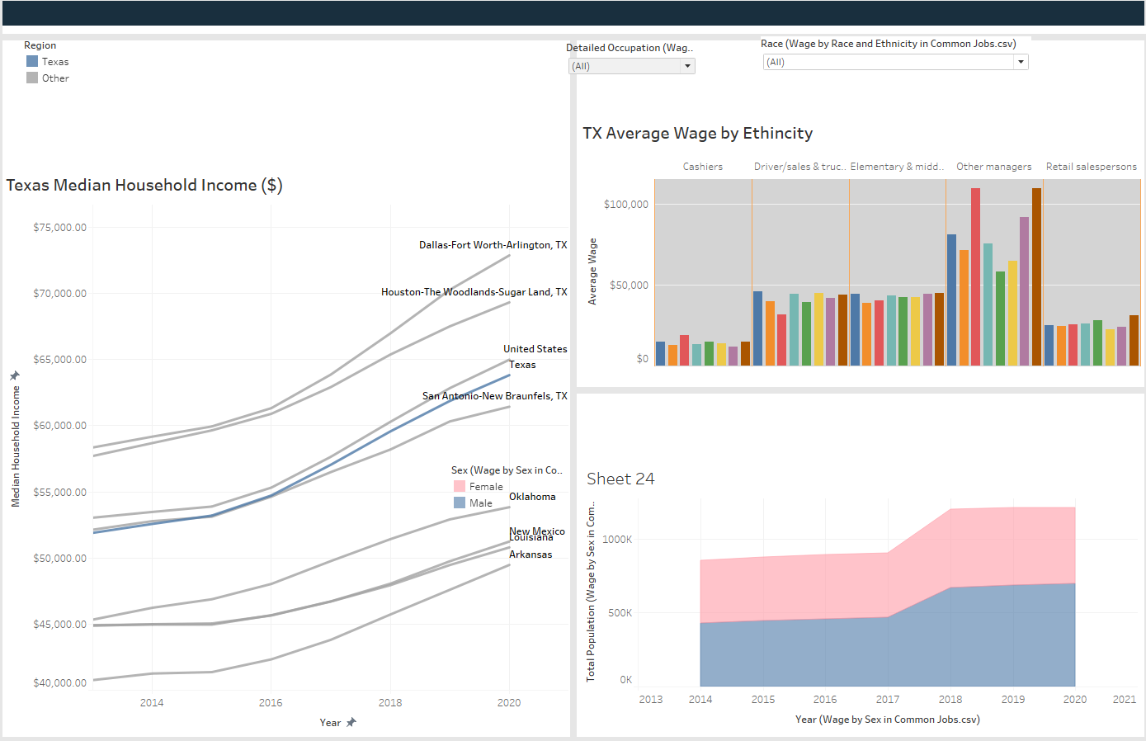

Slide 16
Poverty by Age and Sex
Females 25 - 34
LARGEST DEMOGRAPHIC LIVING IN POVERTY
In Texas, 14.2 percent of the population for whom poverty status is determined (3.98 million out of 28 million people) lives below the poverty line, which is higher than the national average of 12.8 percent. Females aged 25 to 34 are the most likely to be poor, followed by Females aged 18 to 24, and then Females aged 35 to 44.
The Census Bureau uses a set of money income thresholds that vary by family size and composition to determine who classifies as impoverished. If a family's total income is less than the family's threshold than that family and every individual in it is considered to be living in poverty.

Slide 17
Poverty by Race and Ethnicity
White: 2,533,511 ± 14,704
Hispanic : 2,191,157 ± 14,440
Black: 621,903 ± 7,558
White is the most frequent racial or ethnic group living in poverty in Texas, followed by Hispanic and Black. To define who is poverty, the Census Bureau employs a series of monetary income levels that vary according to family size and composition. If a family's total income is less than the family's criterion, the family and all of its members are deemed to be poor.

Slide 18
Employment by Occupations
12.7M 2020 VALUE
1.25% 1 YEAR GROWTH | ± 1.25%
From 2019 to 2020, employment in Texas grew at a rate of 1.25%, from 12.5M employees to 12.7M employees.
The most common job groups, by number of people living in Texas, are Elementary & middle school teachers (346,592 people), Driver/sales workers & truck drivers (333,875 people), and Other managers (314,935 people).

Slide 19
Employment by Industries
12.7M 2020 VALUE
1.25% 1 YEAR GROWTH ± 1.25%
From 2019 to 2020, employment in Texas grew at a rate of 1.25%, from 12.5M employees to 12.7M employees.
Construction (993,462 individuals), Elementary and secondary schools (899,993 people), and Restaurants & Food Services are the most common job sectors in Texas (866,707 people). This figure depicts the share of principal industries for Texas citizens, albeit some of these persons may live in Texas but work elsewhere. Census data is associated with a residential address rather than a work address.

Slide 20
MOST COMMON TRADE PARTNERS
Louisiana $78.1B
California $76.4B
Michigan $74.9B
In 2020, the top outbound Texas domestic partner for goods and services (by dollars) was Louisiana with $78.1B, followed by California with $76.4B and Michigan and $74.9B.
Data from the Department of Transportation Federal Highway Administration Freight Analysis Framework Domestic Flows.

Slide 21
Domestic Production in Dollars
Electronics $292B
Gasoline $210B
Fuel oils $178B
Domestic Trade Growth
Domestic Production in Dollars $2.36T
2020 VALUE IN TEXAS $4.5T
PROJECTED 2050 VALUE IN TEXAS 90.9% growth

Slide 22
4000
3000
2000
1000
0

Slide 23
THANKS!
……

Slide 24
Data Sources and References
https://datausa.io/
https://oui.doleta.gov/unemploy/claims.asp
Bureau of Labor Statistics Current Employment Statistics (CES). https://www.bls.gov/data/#employment
http://www.census.gov/programs-surveys/acs/

